Slide 1


Slide 2
Object Oriented Programming
CS2308
Gentry Atkinson

Slide 3
What makes good code?
Readability: other programmers should be able to understand it.
Reusability: if should be easy to us in other programs.
Security: it should be protected from malicious users.

Slide 4
Do Classes make good code?
Readability: programmers can quickly understand classes in terms of their interface.
Reusability: classes can be moved easily because the interface is consistent.
Security: classes prevent private data from being accessed incorrectly.

Slide 5
Object Oriented Programming
A programming paradigm that asserts that all code (or as much code as possible) should be in classes.
Programs should be written as abstractions of real world objects.
A program is a collection of classes.

Slide 6
Other Paradigms
Procedural: a program is a collection of statements. (We have been using this paradigm).
Functional: a program is a collection of functions. (UT focuses on this paradigm).
Logical: a program is a collection of rules.
(There are many others. These are just a few examples.)

Slide 7
Defining Abstractions
What defines a Dog?
  A name, a breed, an age, and owner.
What can a dog do?
  Change owner.
  Change name.
  Get older.
class Dog{
private:
string name, breed, owner;
int age;
public:
Dog(string, string, string, int);
void getOlder();
void changeOwner(string):
void updateName(string);
//TODO: add getters
};

Slide 8
Member Function Prototypes
class definitions in C++ only have to include a prototype.
Member functions can be defined elsewhere in the same file, or in a different file.
The scope resolution operator :: is used to show that a function definition is part of a class.

Slide 9
Example 1
class C{
private:
string value;
public:
C(string);
string getValue();
void setValue(string);
};
C::C(string v){
value = v;
}
string C::getValue(){
return value;
}
void C::setValue(string v){
value = v;
}

Slide 10
Example 1 cont.
int main(int argc, char** argv){
C instanceOfC("CS");
cout << instanceOfC.getValue();
instanceOfC.setValue(" is ");
cout << instanceOfC.getValue();
instanceOfC.setValue("best!");
cout << instanceOfC.getValue() << endl;
return 0;
} //try to guess the output

Slide 11
Class variables vs.
Instance variables.
The static keyword can be used to make a member variable shared by the whole class.
Every object gets its own copy of an instance (non-static) variable.
All object from the same class share the same copy of a class (static) variable.

Slide 12
Example 2
class C{
public:
static int howMany;
C(){howMany++;};
int getHowMany(){return howMany;};
};
int C::howMany = 0;

Slide 13
Example 2 cont
int main(int argc, char** argv){
C a, b, c, d;
cout << "Class variable: " << C::howMany << endl;
cout << "a's member variable: " << a.getHowMany() << endl;
cout << "b's member variable: " << b.getHowMany() << endl;
cout << "c's member variable: " << c.getHowMany() << endl;
cout << "d's member variable: " << d.getHowMany() << endl;
return 0;
} //try to guess the output

Slide 14
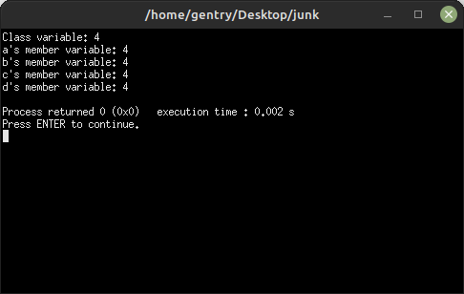
Example 2 cont

Slide 15
Classes with Class Members
Classes can have instances of other classes as members variables.
Class member variables are referenced using two or more dot . operators.

Slide 16
Example 3
class C{
public: int a;
};
class D{
private: C c;
public:
void setC(int c) {
    this->c.a = c;};
int getC(){return c.a;};
};
int main(int argc, char** argv){
D d;
d.setC(5);
cout << d.getC() << endl;
return 0;
} //try to guess the output

Slide 17
Example 4
class C{
private: int a;
public:
void setA(int a)
{this->a = a;};
int getA(){return a;};
};
class D{
public: C c;
};
int main(int argc, char** argv){
D d;
d.c.setA(5);
cout << d.c.getA() << endl;
return 0;
} //try to guess the output

Slide 18
Arrays and Classes
Classes can have arrays as member variables.
Objects can be stored in arrays.

Slide 19
Example 5
class C{
private:
int a[5] = {};
int SIZE = 5;
public:
void printNums(){
for(int i=0; i<SIZE;i++)
cout << a[i] << ' ';
cout << endl;
}
};
int main(){
C c[3];
c[0].printNums();
c[1].printNums();
c[2].printNums();
return 0;
} //try to guess the output

Slide 20
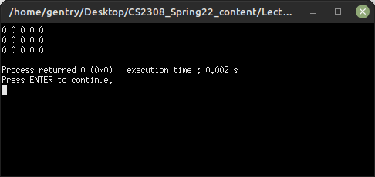
Example 5

Slide 21
Pointers and Classes
Objects can be pointed to by pointers.
Classes can have pointers as member variables.

Slide 22
Example 6
class C{
private:
int *a;
public:
void setA(int* a){
this->a=a;
}
void printA(){
cout << *a;
}
};
int main(){
C c;
int b = 5;
c.setA(&b);
c.printA();
return 0;
} //try to guess the output

Slide 23
Classes and Dynamic Allocation
Pointer member variables of classes can reference dynamically allocated memory.
Objects can be dynamically allocated
Classes that create dynamically allocated video should use their destructor to de-allocate that memory.

Slide 24
Example 7
class C{
private:
int *a;
public:
C(){
a = new int;
*a = 5;
}
~C(){delete a;}
void printA(){
cout << *a;
}
};
int main(){
C* c = new C;
c->printA();
delete c;
return 0;
} //try to guess the output

Slide 25
Questions or Comments?

